Slide 6


Slide 7
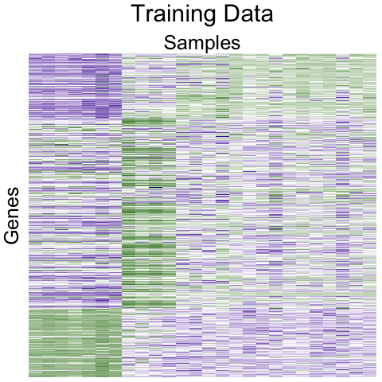
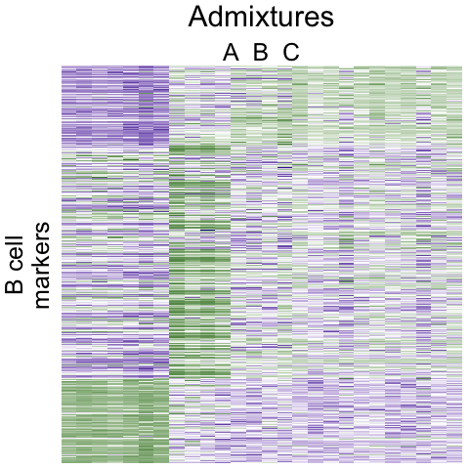



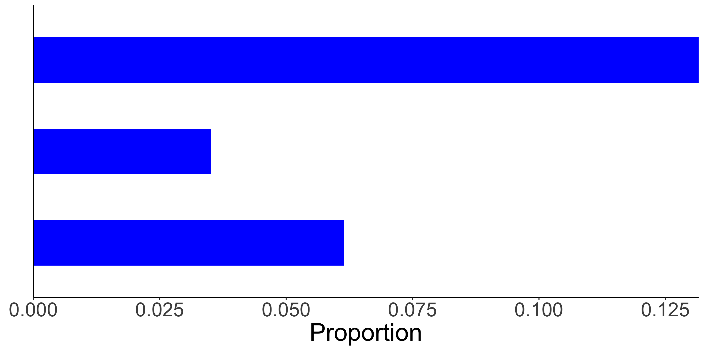
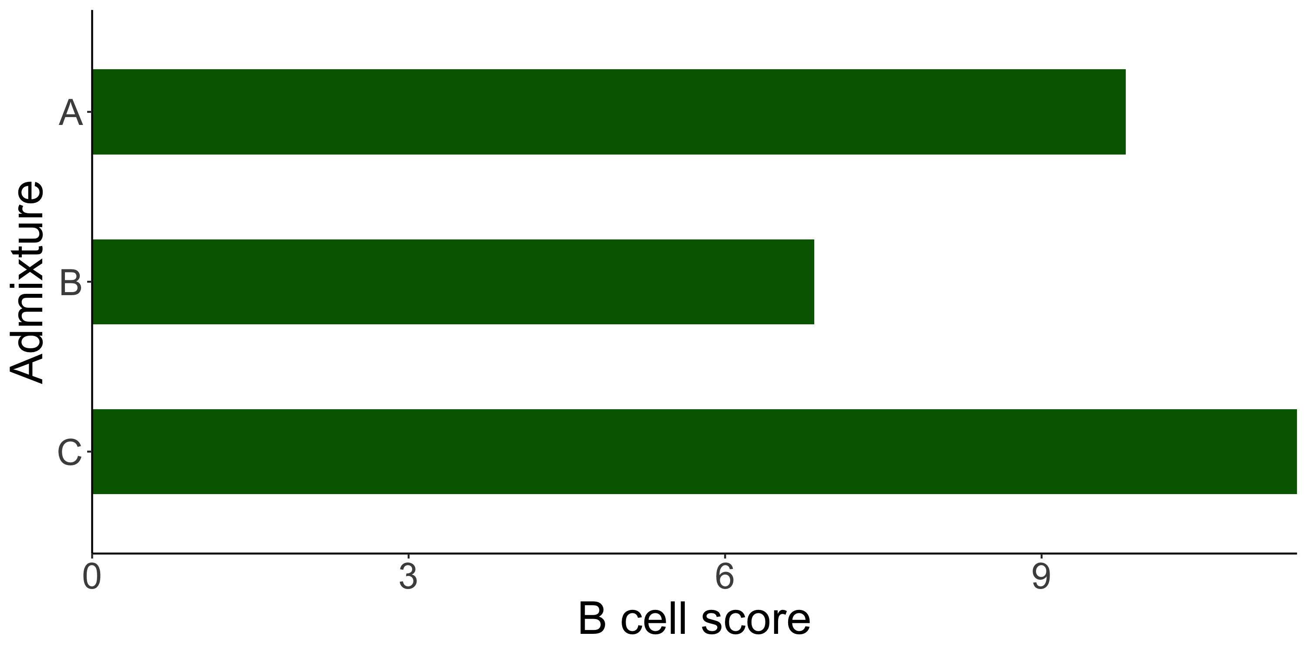

Slide 8
admixture

Slide 9
admixture

Slide 10
NK cell
markers
Cytotoxic T cell
markers
B cell
markers
admixture

Slide 11
NK cell
markers
Cytotoxic T cell
markers
B cell
markers
admixture

Slide 14
NK cell
markers
Cytotoxic T cell
markers
B cell
markers
admixture

Slide 15
NK cell
markers
Cytotoxic T cell
markers
B cell
markers

